Slide 1
II. Probabilistic Models
4. Word Embeddings with neural networks

Slide 2
4. Word Embeddings with neural networks
Gradient descent
One-hot vectors
Neural networks
Word embeddings
Continuous bag-of-words model
Text pre-processing
Tokenization
Data generators

Slide 3
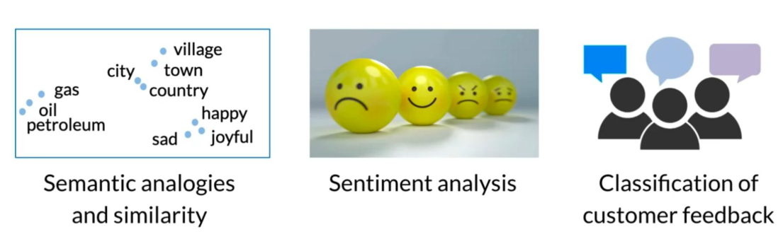
(1) Overview
Some basic applications of word embeddings

Slide 4
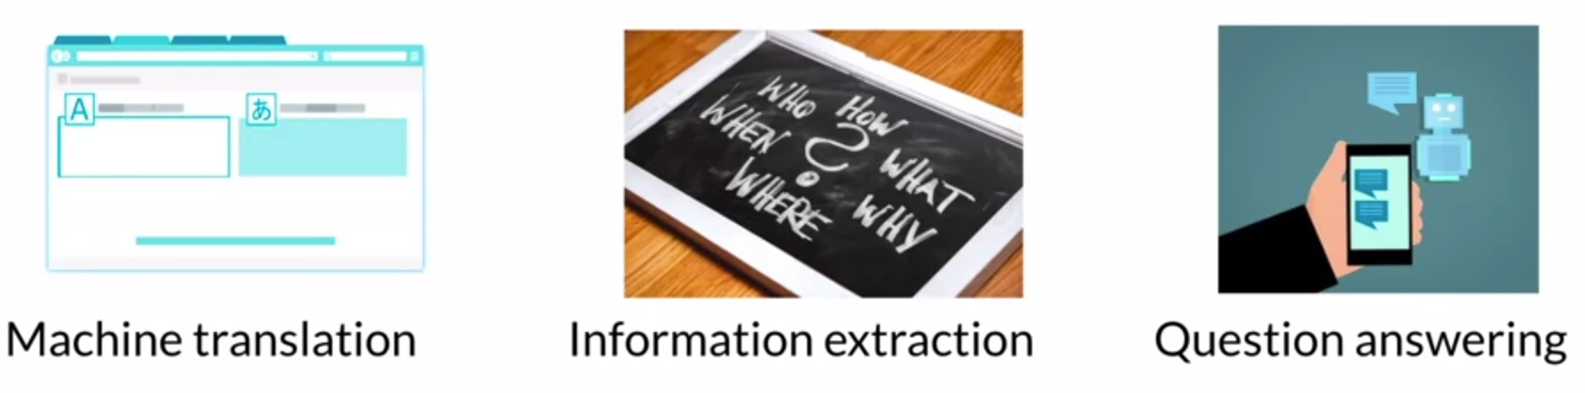
Advanced applications of word embeddings

Slide 5
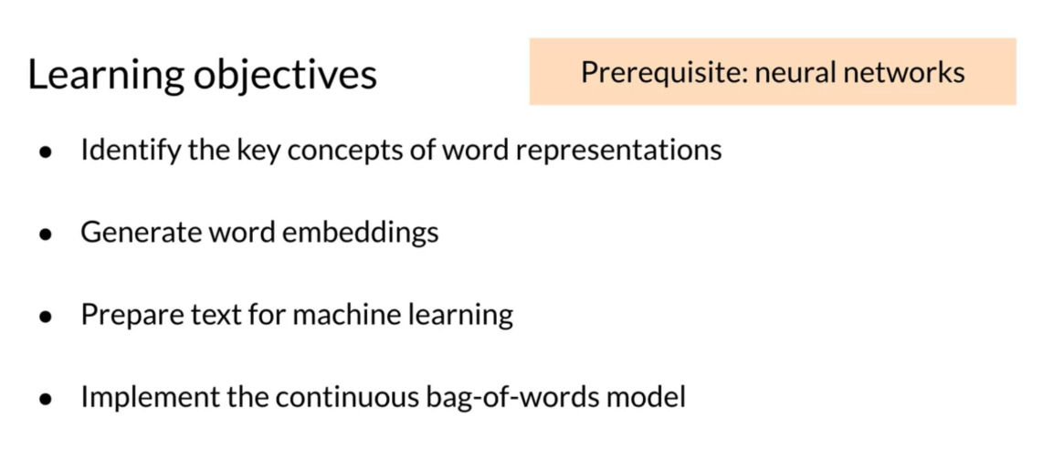
Learning objectives

Slide 6
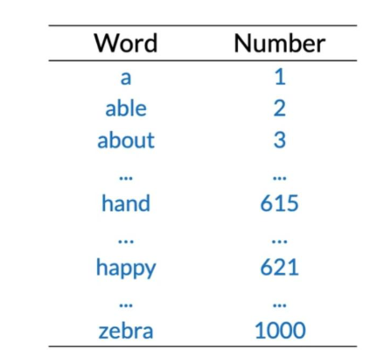
(2) Basic Word Representations
Integers

Slide 7
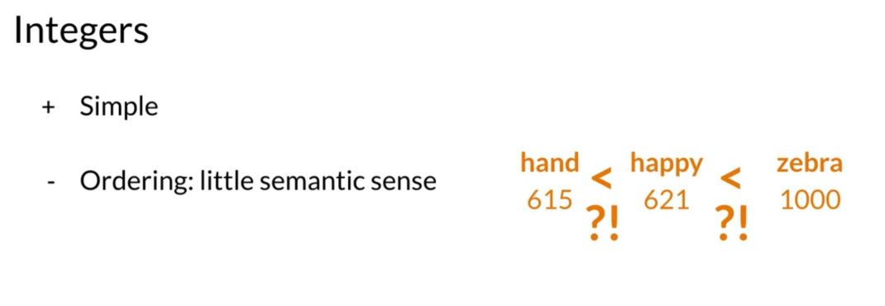
Integers

Slide 8
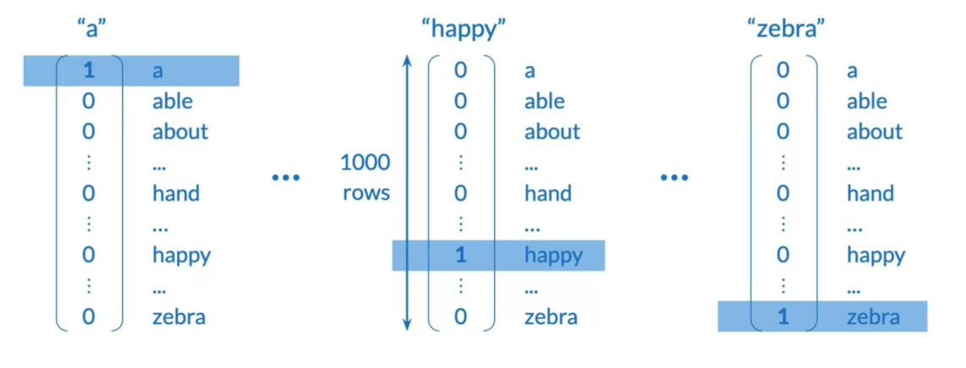
One-hot vectors

Slide 9
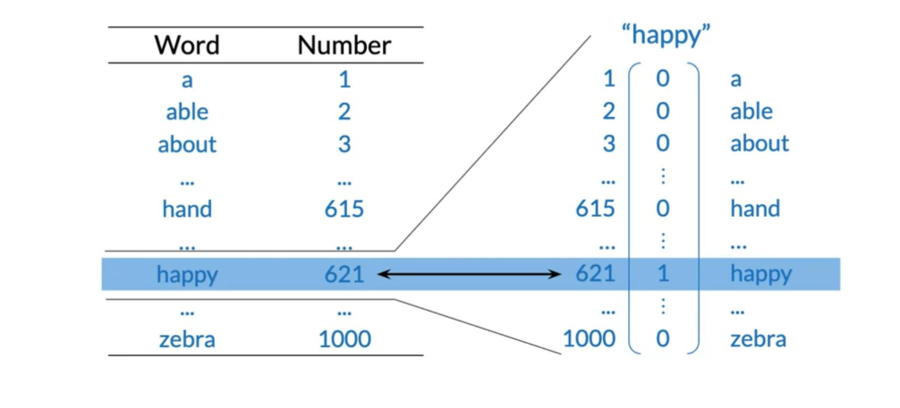
One-hot vectors

Slide 10
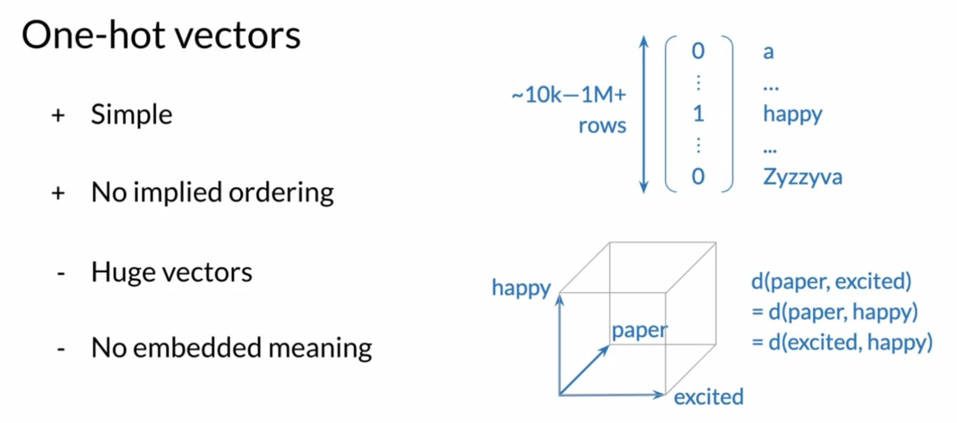
One-hot vectors

Slide 11
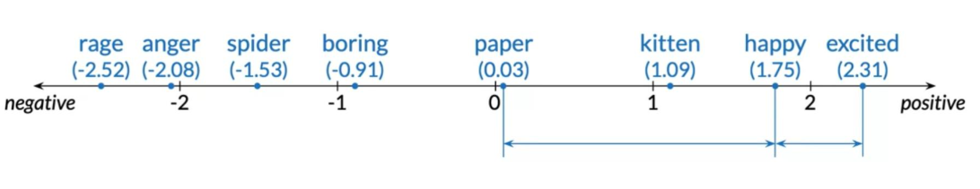
(3) Word Embeddings
Meaning as vectors

Slide 12
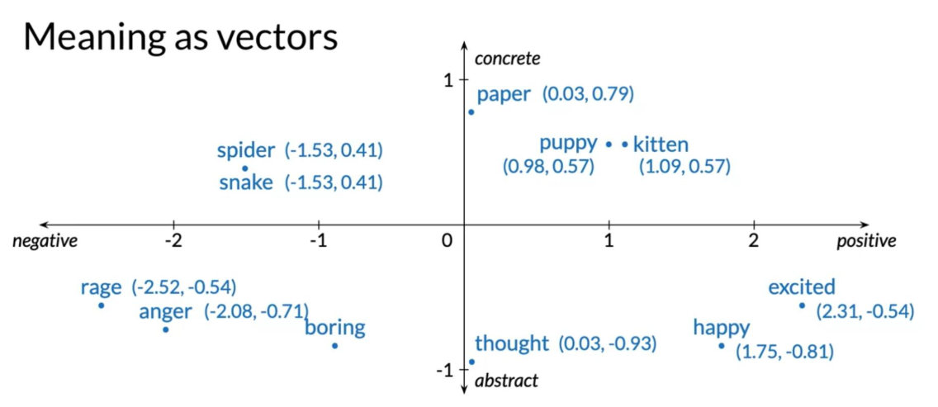
Meaning as vectors

Slide 13
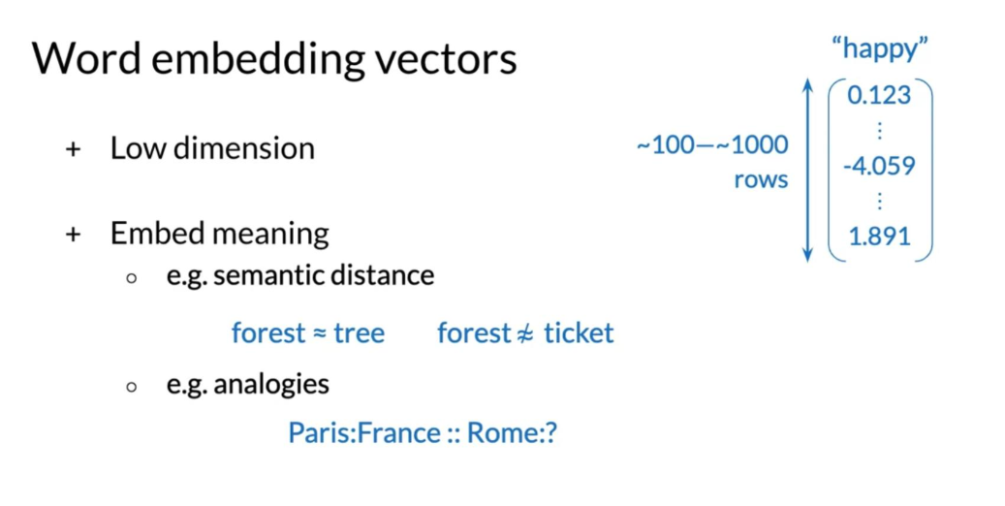
Word embedding vectors

Slide 14
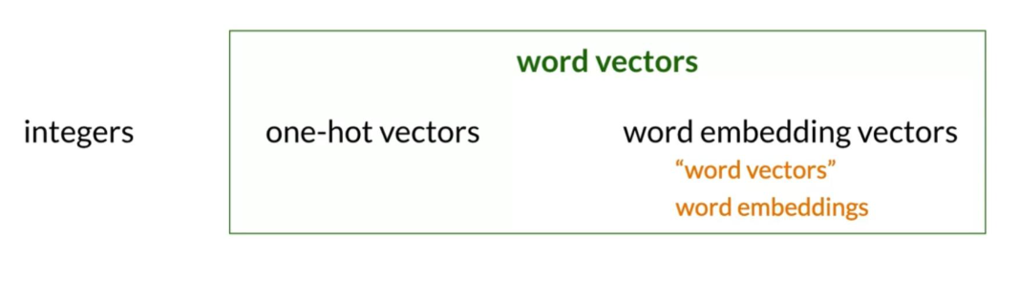
Terminology

Slide 15
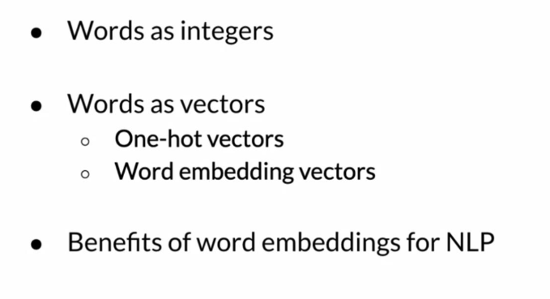
Summary

Slide 16
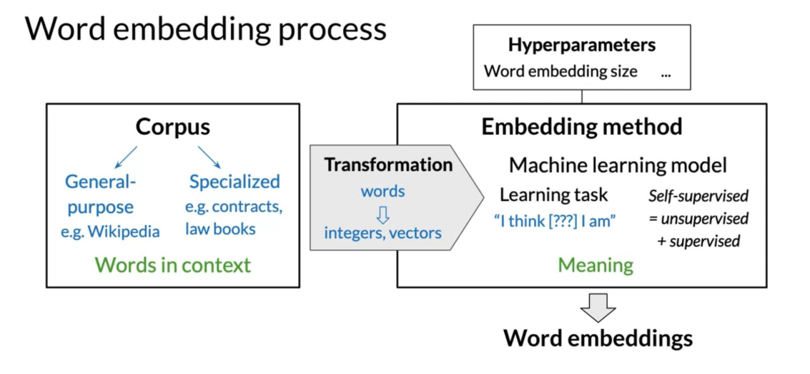
(4) How to Create Word Embeddings
Word embedding process

Slide 17
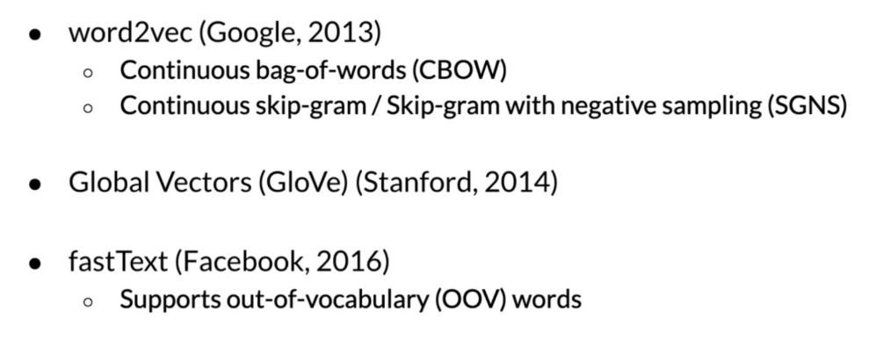
(5) Word Embedding Methods
Basic word embedding methods

Slide 18
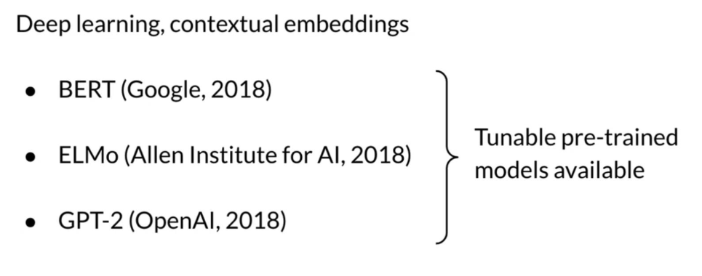
Advanced word embedding methods

Slide 19
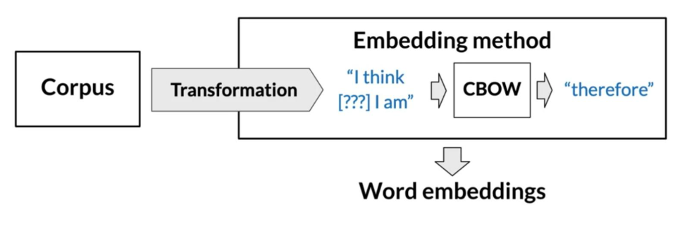
(6) Continuous Bag-of-Words Model
CBOW word embedding process

Slide 20
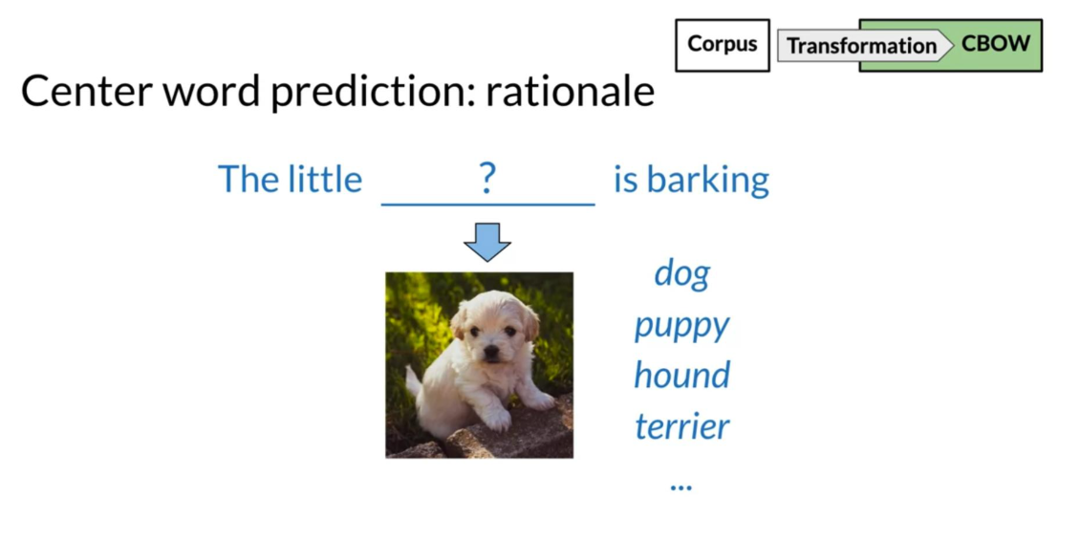
Center word prediction: rationale

Slide 21
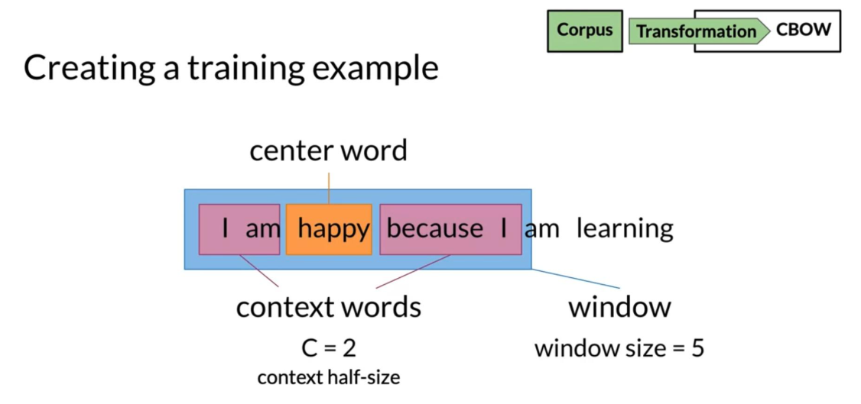
Creating a training example

Slide 22
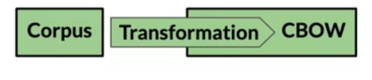
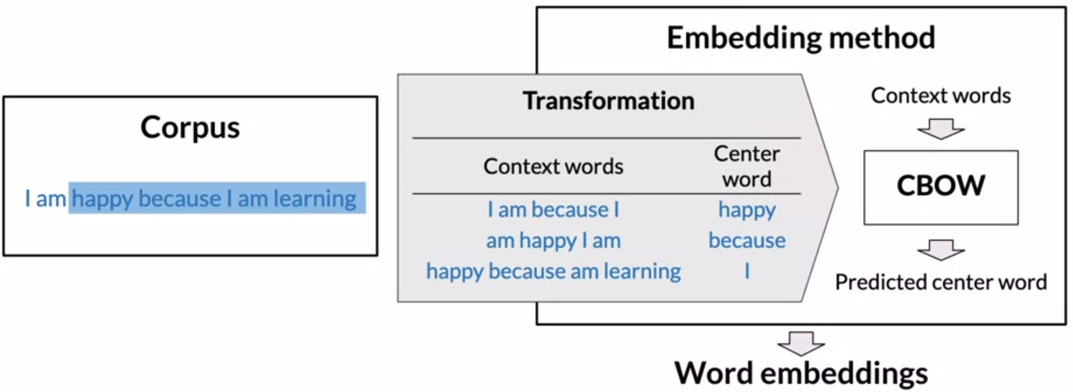
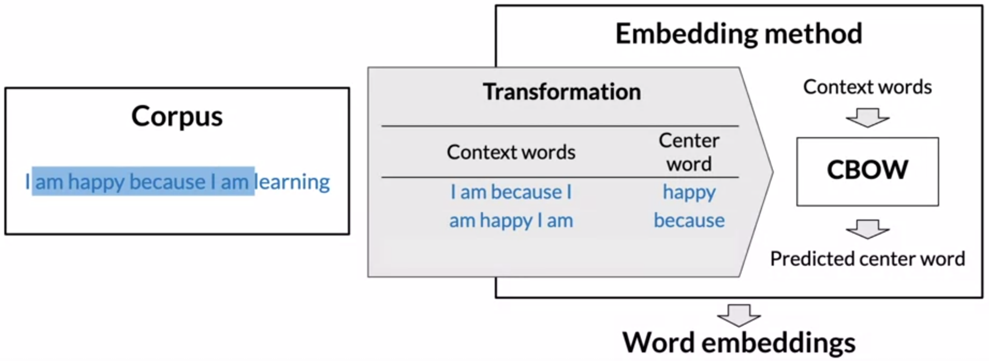
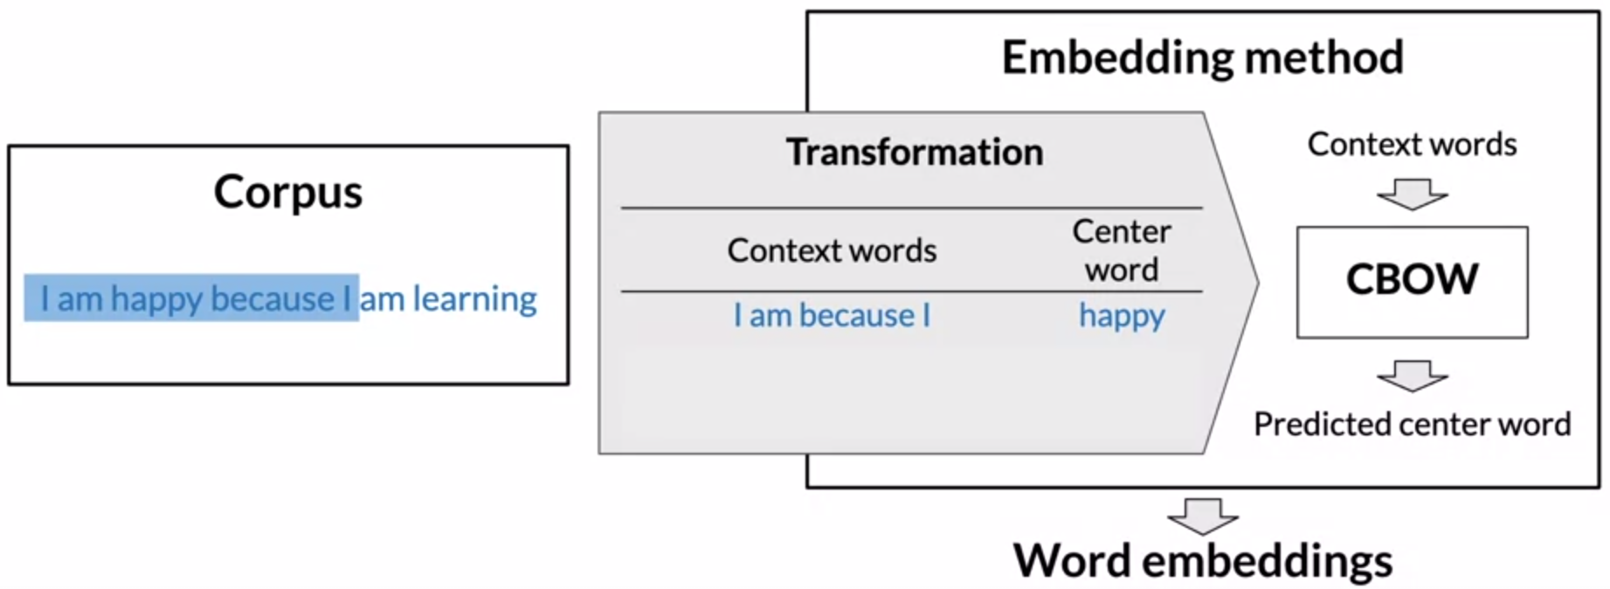
From corpus to training

Slide 23
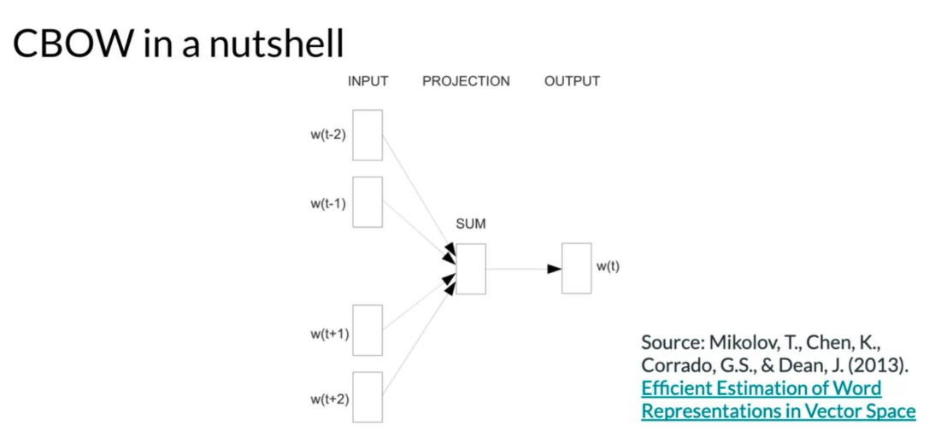
CBOW in a nutshell

Slide 24
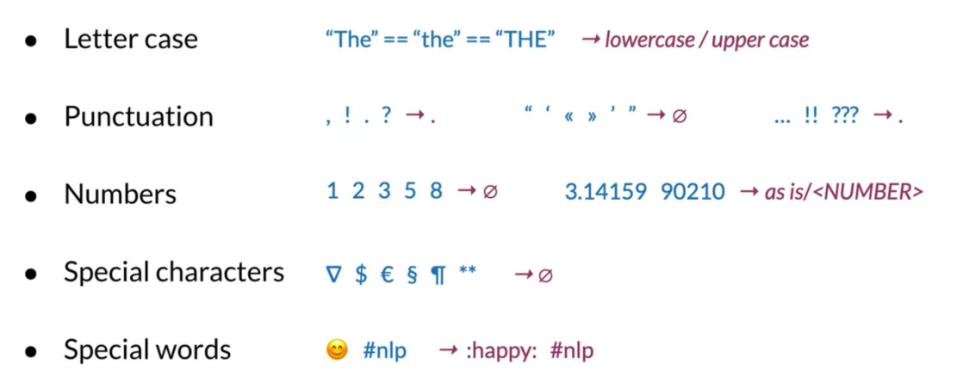
(7) Cleaning and Tokenization
Cleaning and tokenization matters

Slide 25
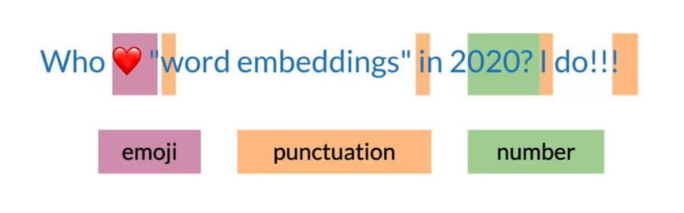

Example in Python: corpus

Slide 26
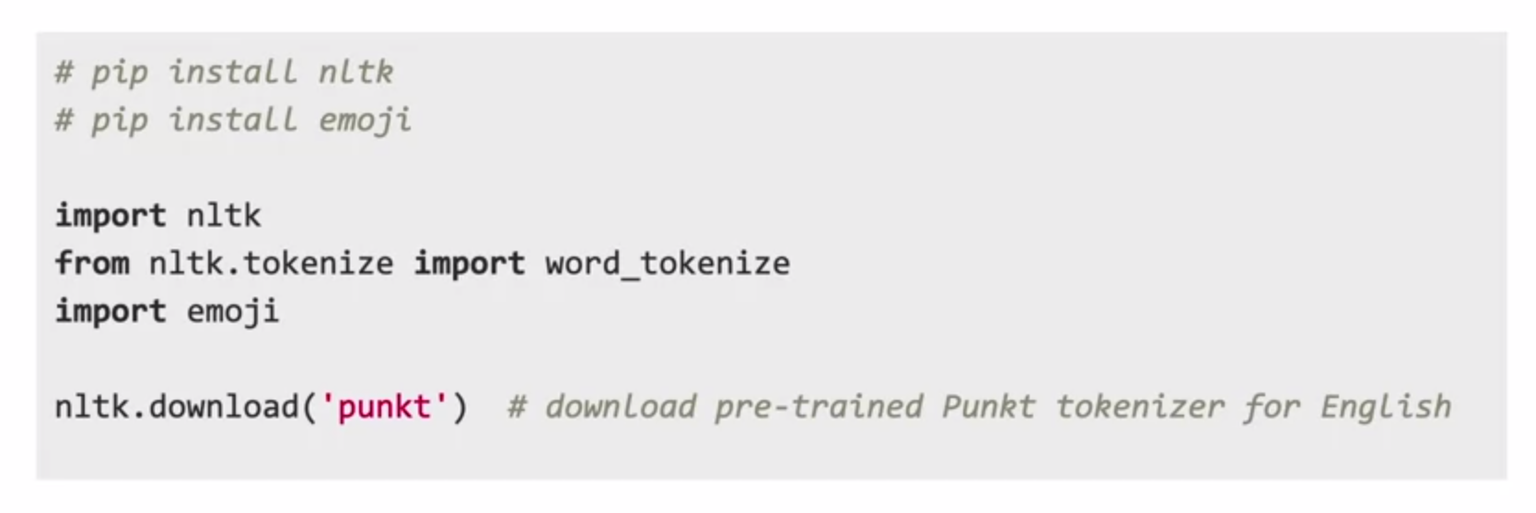
Example in Python: libraries

Slide 27
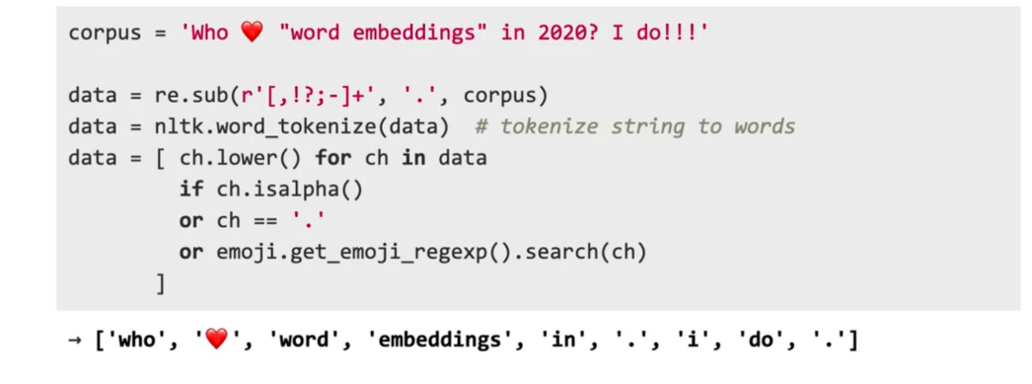
Example in Python: code

Slide 28
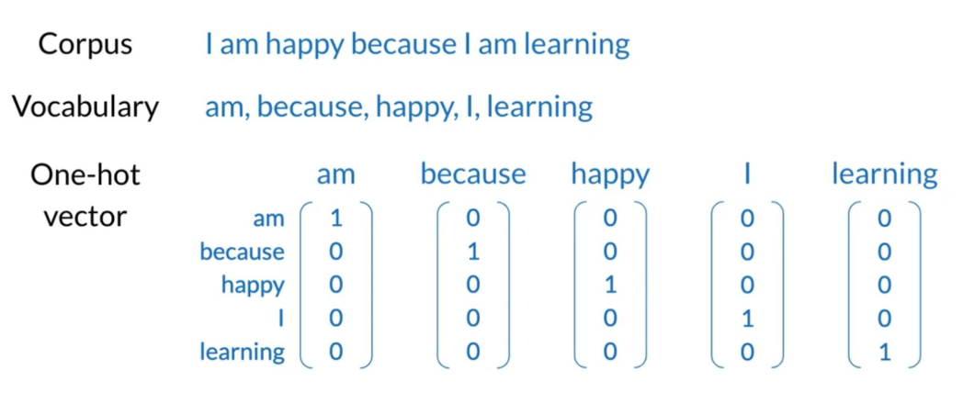
(8) Transforming Words into Vectors
Transforming center words into vectors

Slide 29
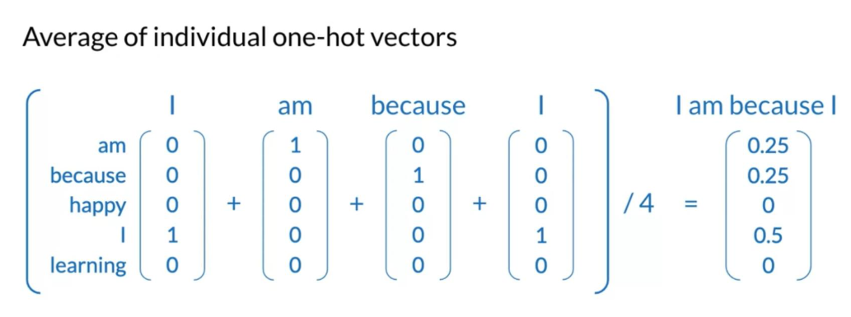
Transforming context words into vectors

Slide 30
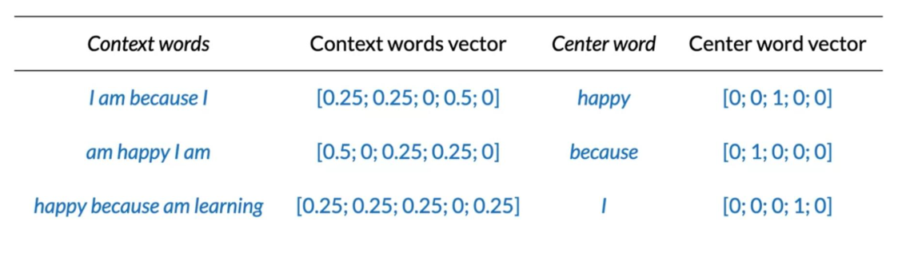
Final prepared training set

Slide 31
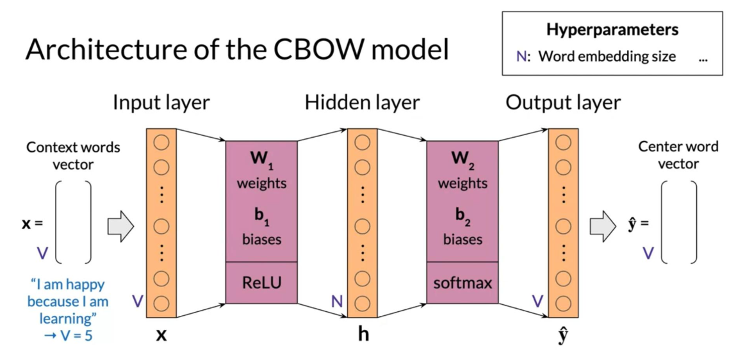
(9) Architecture of the CBOW Model

Slide 32
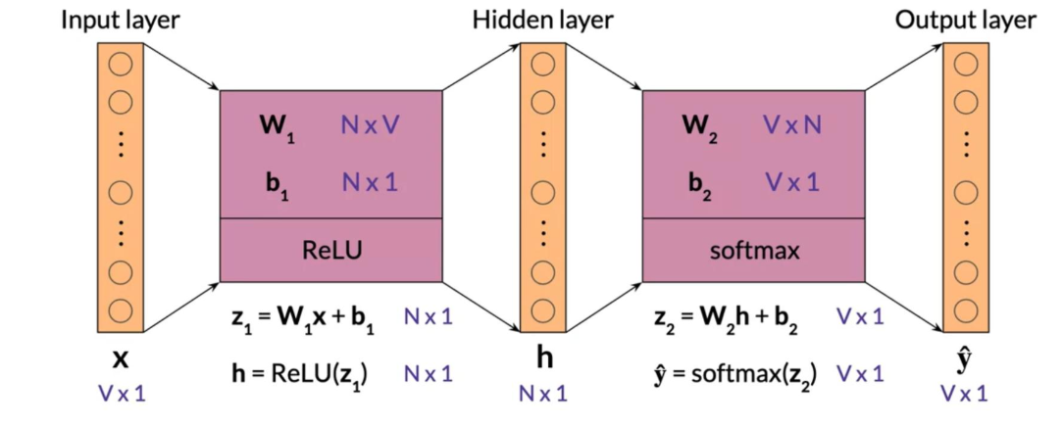
(9) Architecture of the CBOW Model
1) Dimensions (single input)

Slide 33
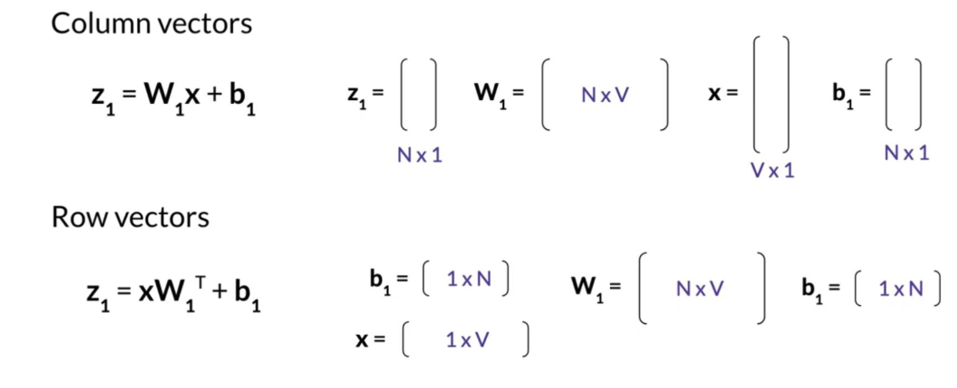
1) Dimensions (single input)

Slide 34
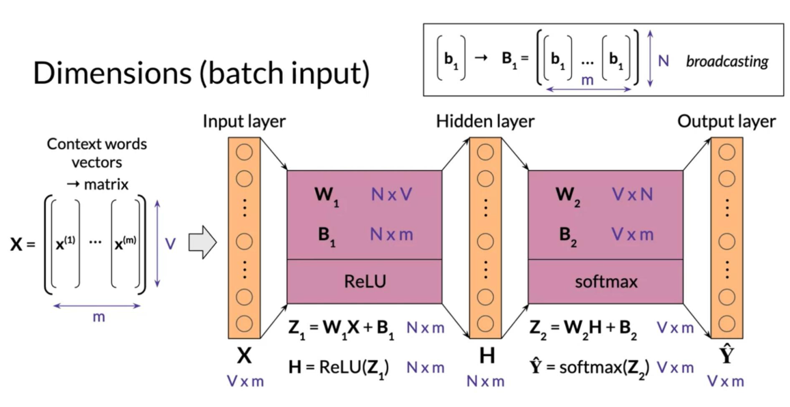
(9) Architecture of the CBOW Model
1) Dimensions (batch input)

Slide 35
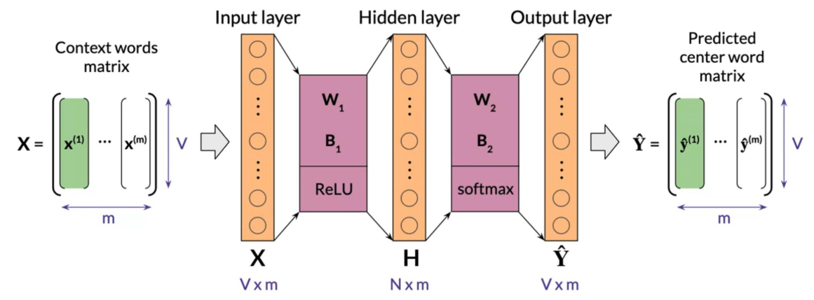
1) Dimensions (batch input)

Slide 36
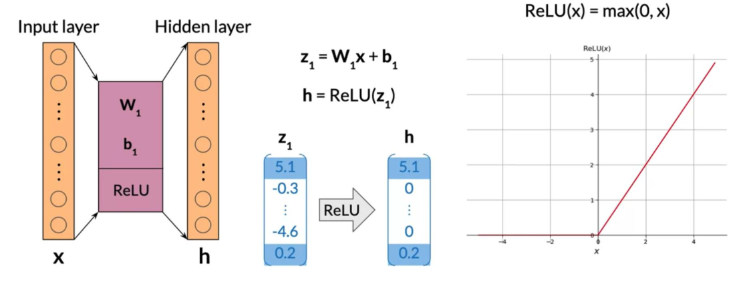
(9) Architecture of the CBOW Model
2) Activation Functions
- Rectified Linear Unit(ReLU)

Slide 37
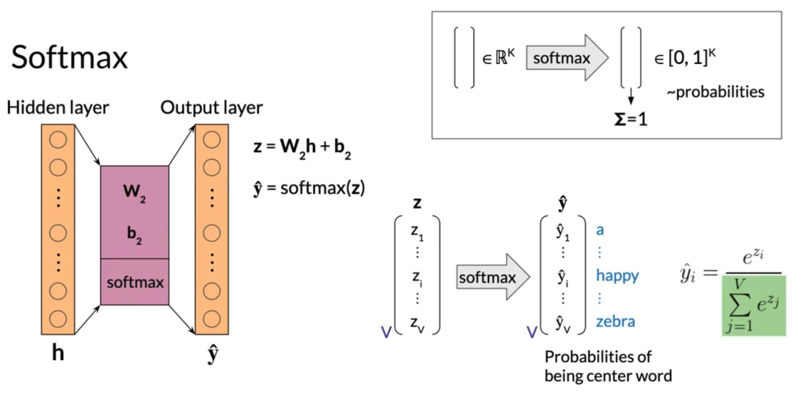
2) Activation Functions
- Softmax

Slide 38
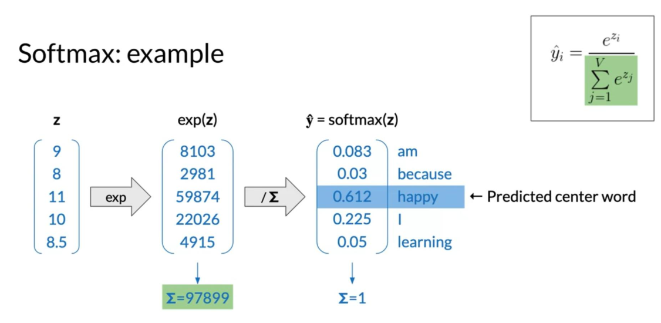
- Softmax: example

Slide 39
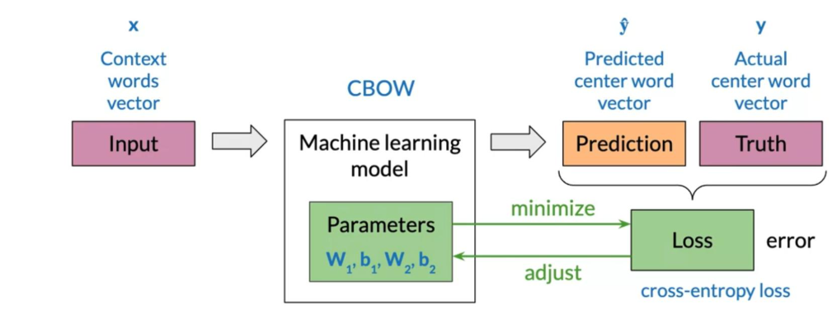
(10) Training a CBOW Model
1) Cost Function
- Loss

Slide 40
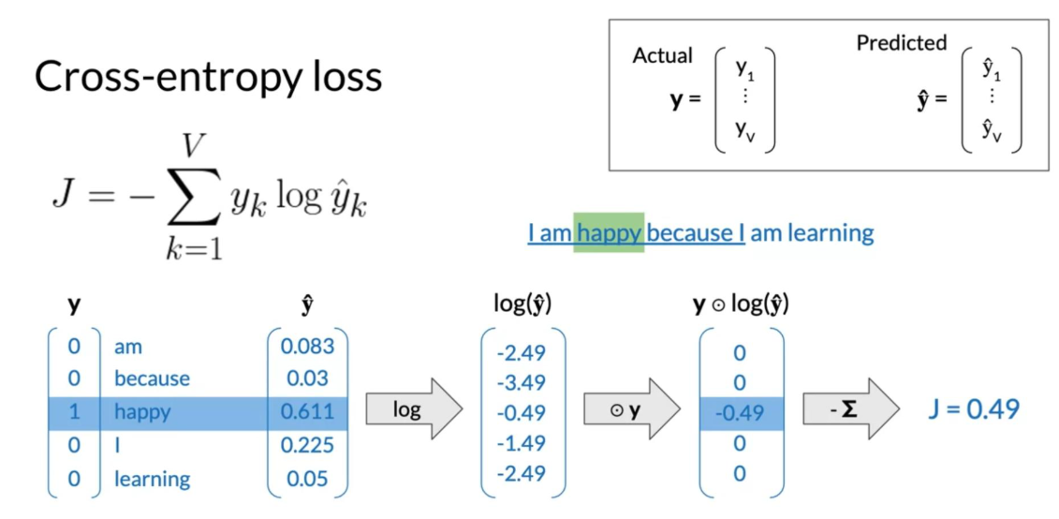
- Cross-entropy loss

Slide 41
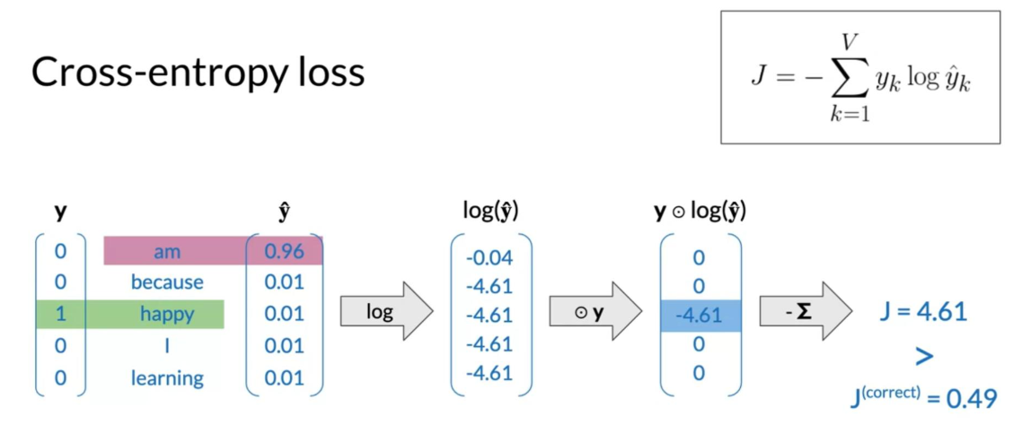
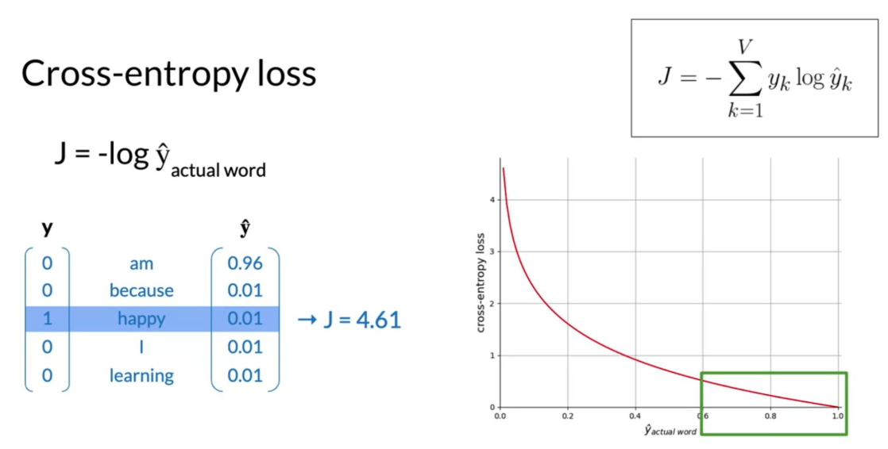
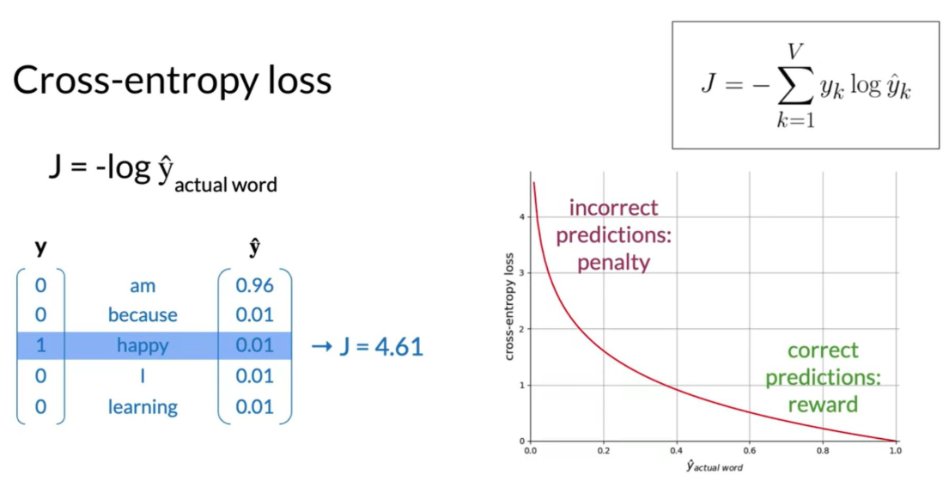
- Cross-entropy loss

Slide 42
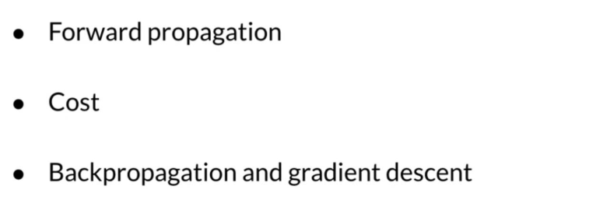
(10) Training a CBOW Model
2) Forward Propagation
- Training process

Slide 43
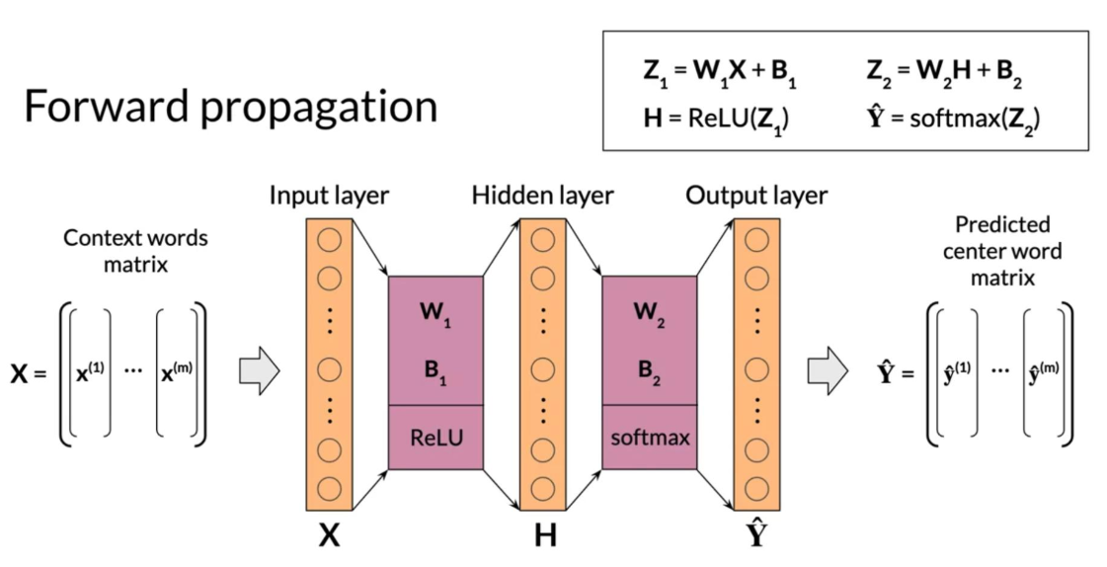
2) Forward Propagation

Slide 44
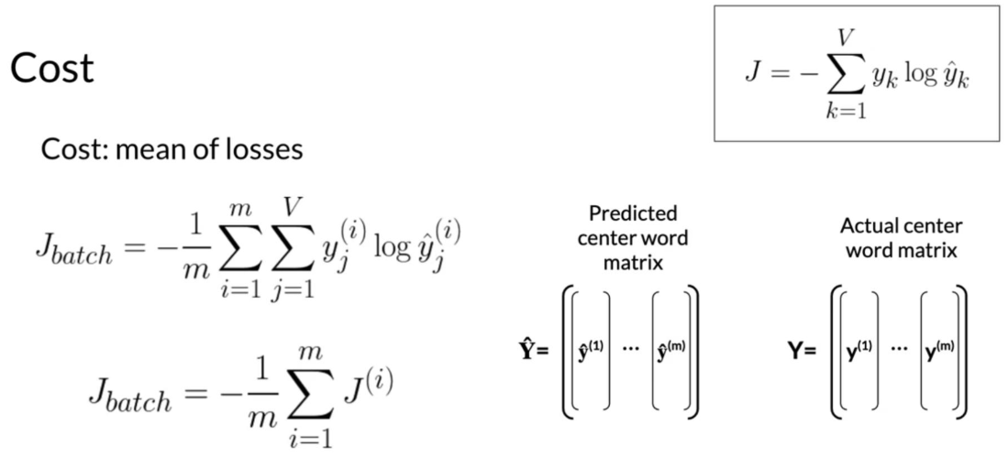
2) Forward Propagation
- Cost : mean of losses

Slide 45
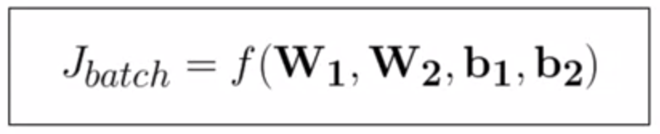
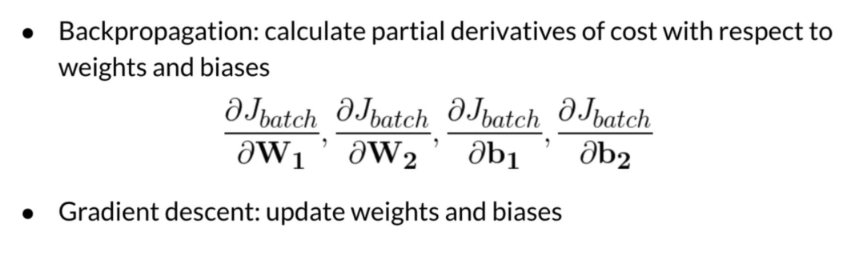
(10) Training a CBOW Model
3) Backpropagation and Gradient Descent
- Minimizing the cost

Slide 46
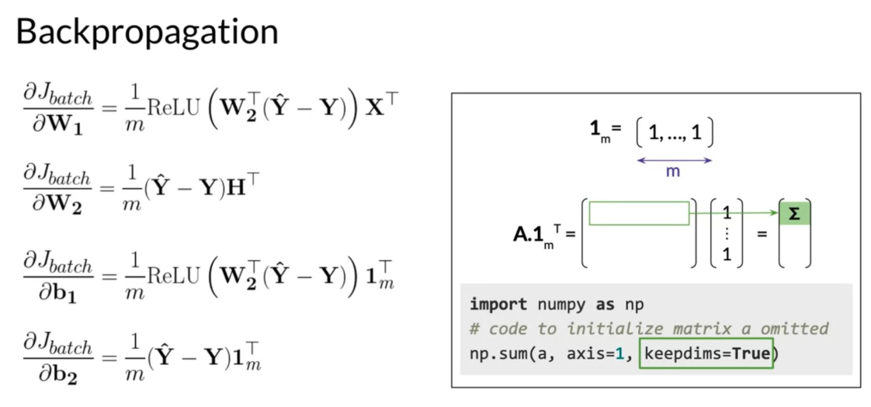
- Backpropagation

Slide 47

- Gradient Descent

Slide 48

(11) Extracting Word Embedding Vectors
- Option 1

Slide 49

- Option 2

Slide 50

- Option 3

Slide 51


(12) Evaluating Word Embeddings
1) Intrinsic Evaluation

Slide 52


1) Intrinsic Evaluation

Slide 53

1) Intrinsic Evaluation

Slide 54

(12) Evaluating Word Embeddings
2) Extrinsic Evaluation

Slide 55

2) Extrinsic Evaluation

Slide 56

(13) Conclusion
Recap and assignment

Slide 57

Going further

